Slide 1



Project «Improvement of services available by citizen card in Jelgava and Siauliai» – e-Card review
29/12/2020

Slide 2



Summary
Project period:
  44 months 28 days
  03/04/2017 – 30/12/2020
  Project budget:
  584 230.23 EUR (ERDF 496 595.69)
Notes:
2

Slide 3
Programm priorities
Priority 4.1:
  Improved quality of living through efficient public services and administration
Specific objective:
  To improve efficiency of public services by strengthening capacities and cooperation between institutions
Notes:
3

Slide 4
Overall objectives
To improve effectiveness of providing and administrating public services, by
Strengthening capacity of municipal institutions and structures, as well as
Increasing usage of city cards in Jelgava and Siauliai, i.e.
  including and centralizing municipal services foreseen for citizens in city e-card, as well as
  ensuring possibility to use these services cross-border
Notes:
4

Slide 5
Specific objectives
Improving of public services provided by municipalities as e-services in e-Card
Increase the number of e-Card users or citizens using modernized services
Improvement of cross border cooperation
Notes:
5

Slide 6
Main outputs
Research
Smart City concept
Best case exchange
Providing e-services for public services available by city cards
During cross border cooperation of 2 municipalities there will be:
improved public services linked with allowances and discounts offered by municipality and
so access to services is linked to citizen Card with improved and new e-modules

Slide 7
Main expected project results
Improved public services linked with allowances and discounts offered by municipality
access to services is linked to CityCard with improved and new e-modules
In the project 3 modules are planned that will develop services available by cards;
as result citizens are using cards of cities more, thus relieving municipal institutions and increasing their living quality;
cross border cooperation between municipalities, their specialists and citizens increased

Slide 8
Target groups
Local authorities
infrastructure and (public) service providers:
  2 x 5, e.g., JSC “Busturas”, ambulances, sports centers, markets, municipality operational information centers, IT departments, accountancy, educational board / department of education, social affairs / social support, libraries from both cities
interest groups including NGOs:
  At least 2 x 10
General Public
Notes:
8

Slide 9
Work packages
Work package | Real time schedule
Management | 03/04/2017 – 30/12/2020
Cross-border experience based research and concept | 03/04/2017 - 14/11/2019
Development and piloting | 03/04/2017 – 30/12/2020
Communication | 03/04/2017 – 30/12/2020
Notes:
9

Slide 10
Cross-border experience based research and concept
Done
Research: preparation
Done
Research: meetings
Done
Research
Done
Concept: preparation
Done
Concept: meetings of work group
Done
Meetings with focus groups
Done
Elaboration of concept
Done
Exchange of best case experience
Notes:
10

Slide 11

WP Cross-border experience based research and concept - RESEARCH
Jelgava:
September 2017 till January 2018
Siauliai:
November - December 2017
Research Subject: development and improvement of services of e-Cards (City Cards) available for inhabitants of Jelgava and Siauliai.
Objective of research:
to evaluate the possibilities of improving processes of e-services, ensuring better compliance with the needs of the inhabitants and better access to municipal services;
to find out about the attitude of the inhabitants about e-services, related experience and expectations.

Slide 12
RESEARCH - Conclusions
Results of qualitative research for both project partners showed, that focus group participants consider e-Card as good way to pay for services and e-Cards are easy to use.
Jelgava:
generally satisfied up 80% of the total inhabitants;
At the same time - only half of the valid Jelgava E-cards are used for transport and catering services payments, while other E-cards are used in other cases or are not used
Siauliai:
problems with e-tickets were identified in Siauliai case: limited functions, technical problems and lack of information
In most cases, dissatisfaction with the quality of the e-ticket arises from misunderstanding, e.g., how you need to use it (especially if you experience extraordinary situations).
Results of research were used as base material for development of SmartCity concepts in both cities defining further steps that have to be done in development of cards during the project and in long term.

Slide 13
WP Cross-border experience based research and concept - CONCEPT
Jelgava
  February 2018 till May 2018
Siauliai
January 2019 till November 2019
Concept Subject: to prepare a concept on how to improve the efficiency and administration of public and private services provided to the residents of Siauliai and Jelgava by strengthening the capacity of municipal institutions and structures using IT solutions.
Concept structure:
Evaluation of the current situation and description of the existing problems;
Objectives of the measures included in the concept;
Description of conceptual solutions
vision of short-term and long-term goals, analysis of alternatives that would meet the wishes of the population, etc.

Slide 14
CONCEPT - Short-term and long-term goals based on elaborated Concept
Jelgava:
Development of City loyalty program
Development of the city ISO 37120 data collection, storage and analysis model SmartCity Monitor
  VIAS integration with various supplier data systems (utilities, etc.).
Development of autonomous services:
  Extension of autonomous services from calculation and execution of payments to standalone services using different event types, integration with interactive documents;
  Integration with online systems of various service providers (eveselibaspunkts.lv etc.).

Slide 15
CONCEPT - Short-term and long-term goals based on elaborated Concept
Creation and development of smart tools (development of resident e-card)
  Resident profile e-Telpa.lv as a means of integration with the external supplier online services;
  Resident mobile app as billing and communication tool using interactive documents;
  Registration of various cards as a resident e-card;
  Creation of a universal resident card that can be used identification, communication and payment of various settlements accounts.
Implementation of smart places
  City loyalty program label with square code and / or NFC chip;
  Placement of a Bluetooth beacon for the city loyalty program;
  Bluetooth beacon placement for tourism and others objects / services;
  Placement of means of identification in schools, clinics, hospitals, interest education groups, etc .;

Slide 16
CONCEPT - Short -term and long -term goals based on elaborated Concept
Siauliai:
Smart transport- Optimized transport system would contribute to the improvement of the quality of life for Siauliai residents;
Smart enviorement - City maintenance and development would be carried out in a transparent manner;
Smart residents - a smart resident could use the required services in the most convenient way for him. Resident communities would be active and contribute to the wellbeing

Slide 17
CONCEPT - Short -term and long -term goals based on elaborated Concept
Smart governance - Citizens and businesses would have the opportunity to provide their feedback on public services, thus helping to improve the quality of services.
Smart life - Feedback opportunities should be provided so that residents and businesses have the opportunity not only to receive information relevant to them, but also to give their opinion on events that are important to them in the city.
Smart economics - City residents would experiment and create new ideas, existing businesses would expand their activities and create new products. And the city of Siauliai would actively use the status of a smart city and business support activities carried out in the city to attract marketing and investments.

Slide 18
Development and piloting
done
E-modules: preparation
done
Adaptation
done
Elaboration of e-modules
done
Consulting and training for implementation
done
Terminals: preparation
done
Supply of terminals
done
Piloting of new services
done
Analyses of piloting results
Notes:
18

Slide 19
e-Modules
3 e-modules were elaborated:
e-module "Discount management"
e-module "Registration of e-cards and rules for calculating discounts"
e-module "Managing classificators" (elaborated by Jelgava and transferred to Siauliai).
Notes:
19

Slide 20
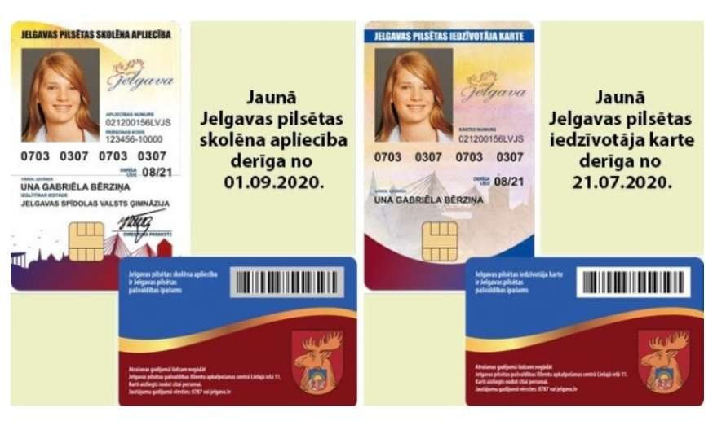
e-Modules - Jelgava Citizen Cards
Jelgava city student e-card can be used:
to receive allowances in public transport in Jelgava;
to provide allowances for school meals;
as a Reader's Card in all Latvian libraries;
for registration for group and extracurricular activities;
for personal identification;
as a subscription ticket carrier for paid tickets;
Notes:
20

Slide 21
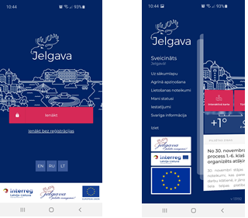
e-Modules - Mobile app «Jelgava»
Citizens have the opportunity to:
  use the app without authentication;
  authenticate in the app;
  to find out the topicalities and news of Jelgava municipality;
  browse your statuses and the statuses of your minor children in a convenient way;
  correct your personal contact information;
  view the allowances granted;
  view subscription tickets;
  get discounts in Jelgava;
  get discounts in Siauliai with QR code;
  mark events on the interactive map in Jelgava, etc.
Notes:
21

Slide 22
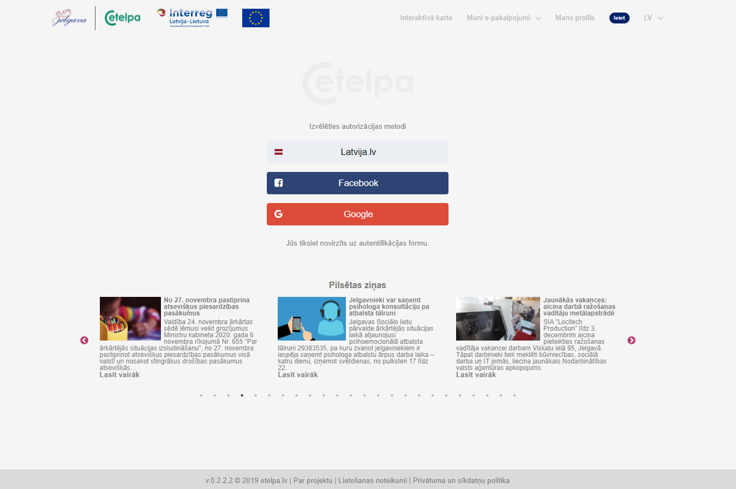
e-Modules - municipal portal «eTelpa.lv»
Recipients of municipal allowances have the opportunity to:
authenticate through Latvija.lv;
link a resident's profile to eTelpa.lv, your social network account or e-mail;
look at your social status;
the resident can receive information about social support promptly;
see the allowances given to yourself and your children;
receive feedback to the municipality;
manage your e-cards;
see what merchant discounts are available;
see what transactions have been made with the card and what benefits have been received for these transactions;
Purchase season tickets for municipal public transport.
Notes:
22

Slide 23
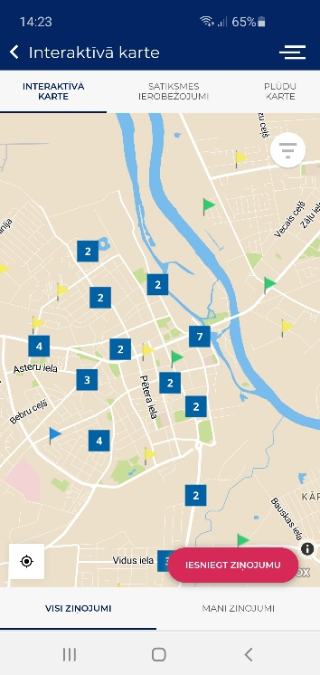
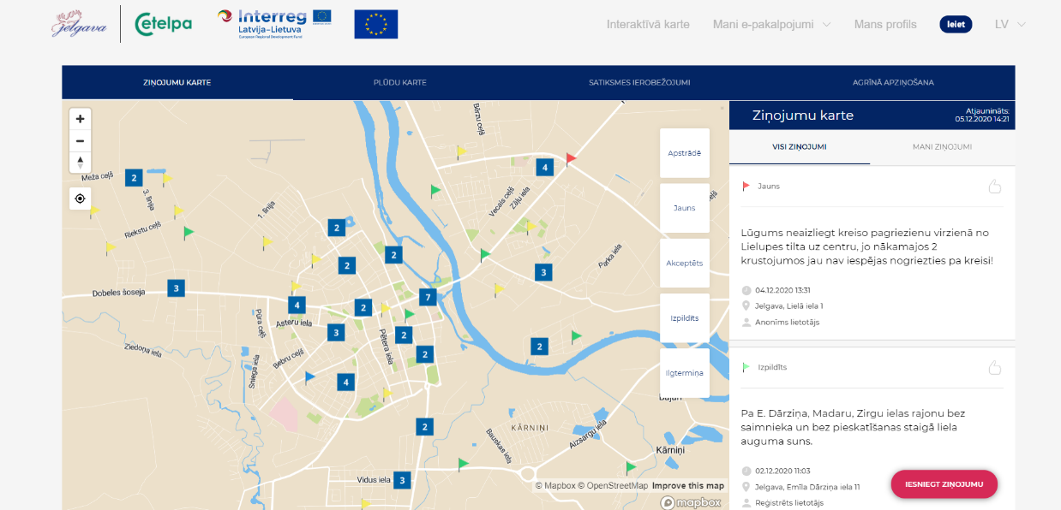
e-Modules - interactive card in eTelpa.lv and mobile app
Both residents and any visitors to the city have the opportunity to register events in the city and they are displayed on the map, while representatives of the municipality have the opportunity to see the registered events and respond to reports. The interactive map provides an opportunity to follow events in the city in real time (including showing statistics on information requests at a specific location).
Notes:
23

Slide 24
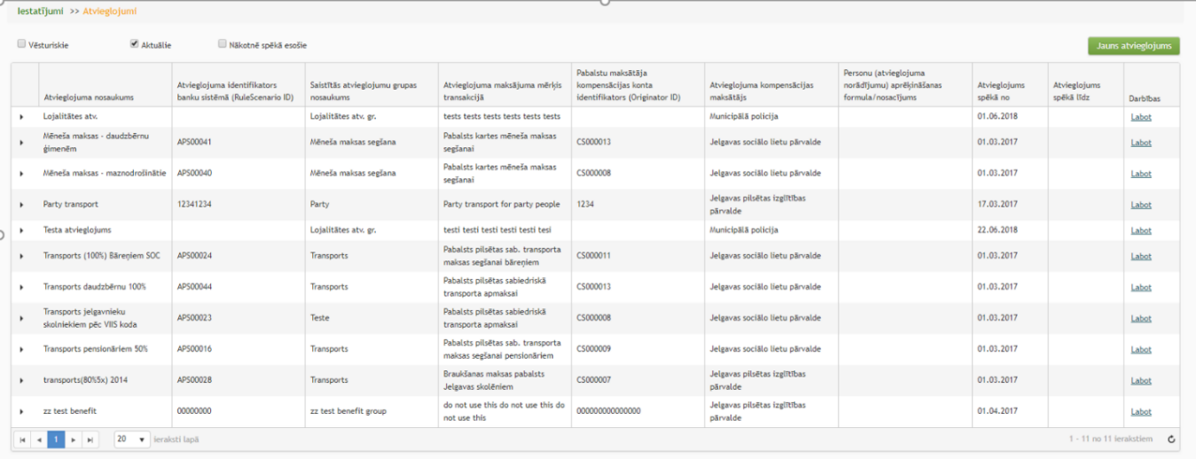
e-Modules - VPS module «eAtvieglojumi.lv»
A system of real-time social benefits, social services and discounts with the help of the VPS module “eAtvieglojumi”, which, using various IT solutions of the municipality and businesses, allows to receive the granted municipal allowances when paying for services.
New users - Zemgale Region Competence Development Center and Jelgava Municipal Operational Information Center.
Notes:
24

Slide 25
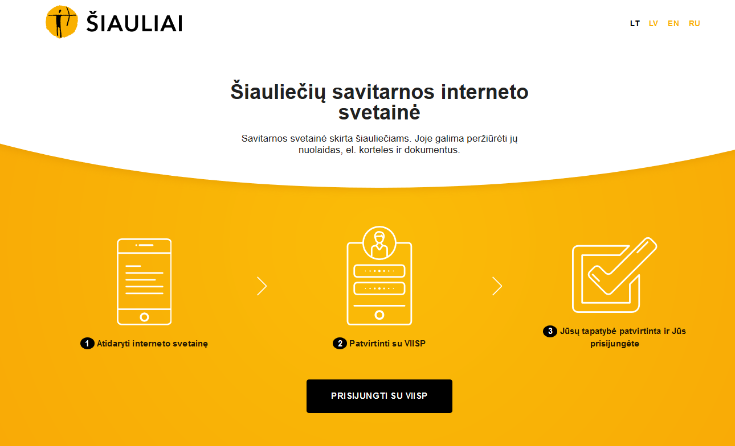
e-Modules Siauliai - Siauliai Citizen Portal
city residents can adjust their contact details,
see their own and their minor children's physical cards and the operations performed with them,
See the discounts that have been assigned to them personally, as well as the discounts they have already used.
Notes:
25

Slide 26
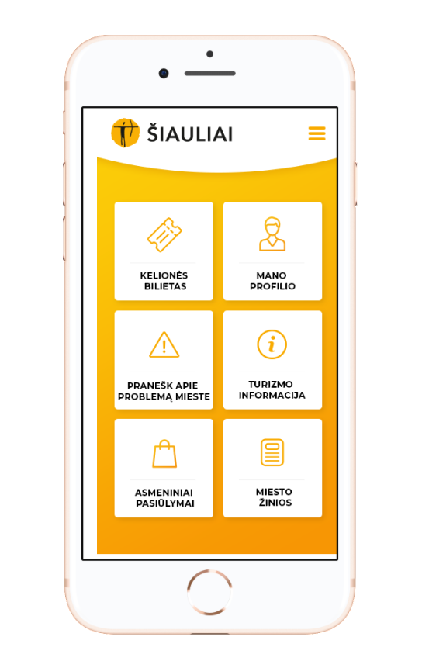
e-Modules Siauliai - Siauliai Citizen Portal
can find out the city's news
view the calendar of events in Siauliai and Jelgava.
get acquainted with Siauliai city tourism objects there, to plan the most convenient route to them.
Additionally, using the mobile app, users are directed to the purchase of public transport tickets
can plan the most convenient route to the point of interest (combining public transport and walking)
can get their personalised discounts in Jelgava.
Notes:
26

Slide 27
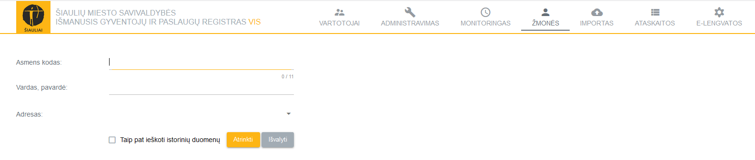
e-Modules Siauliai - Smart Population and Service Register
the Population Register module acts as a common information base for the city's population
it includes all persons who have declared their place of residence in Šiauliai.
The use of web-based services, as well as direct integrations, ensures the timely retrieval of information from other databases.
The card registration and discount calculation rules’ module works in interaction with the discount management module, so employees have the opportunity to create discounts, set important discount parameters such as the amount of the discount, etc.
Notes:
27

Slide 28
e-Modules
Terminals
5 terminals for Jelgava (purcahsed on April 2020)
  Jelgava 6th Secondary School (swimming pool)
  Preschool educational institution "Kāpēcīši" (swimming pool)
  Children and youth center "Junda"
  Preschool educational institution "Rotaļa" (swimming pool)
  Jelgava City Municipality Institution “Kultūra”
Analyses of piloting results
December 2020 for both project partners
Notes:
28

Slide 29
Communication
done
Start-up activities including communication
done
Digital activities (Project information and regular news)
done
Digital activities (brochures, videos, etc.)
done
Conference
Notes:
29

Slide 30
WP Communication
Start up activities:
  Posters at least A3
  Press releases
  Communication plan
  Digital activities:
  Regular news on webpages at least once in 3 months (on partners websites and/or latlit.eu)
  Digital activities (for Siauliai):
    Video
    Brochures
    Banner

Slide 31
Management
Done
Establishment of project management bodies and procedures for project implementation
Done
Signed partnership agreement
Done
Kick-off meeting on 07/06/2017
Done
Project monitoring and coordination - planned 7 internal progress reports, done 14
Done
Project reporting – planned 12, done 18
Done
Project meetings and communication – planned 9, done 3 Steering group meetings, 15 PM meetings
Done
Participation in program events – planned 3, participated in 4
Notes:
31

Slide 32
Management
Meetings:
Kick-off meeting
3 Steering committee meetings
2 Best case exchange meetings
15 project management meetings
Reports:
14 internal progress reports
12 Project partner reports
6 Consolidated reports
Procurements:
Research price surveys
Concept price surveys
E-Module procurements
Terminal procurement for Jelgava
PR campaign procurement for Siauliai
Programme events:
Attended 4 program events (3 – LV, 1 – LT)
Notes:
32

Slide 33

Thank you for your attention!

