Slide 1
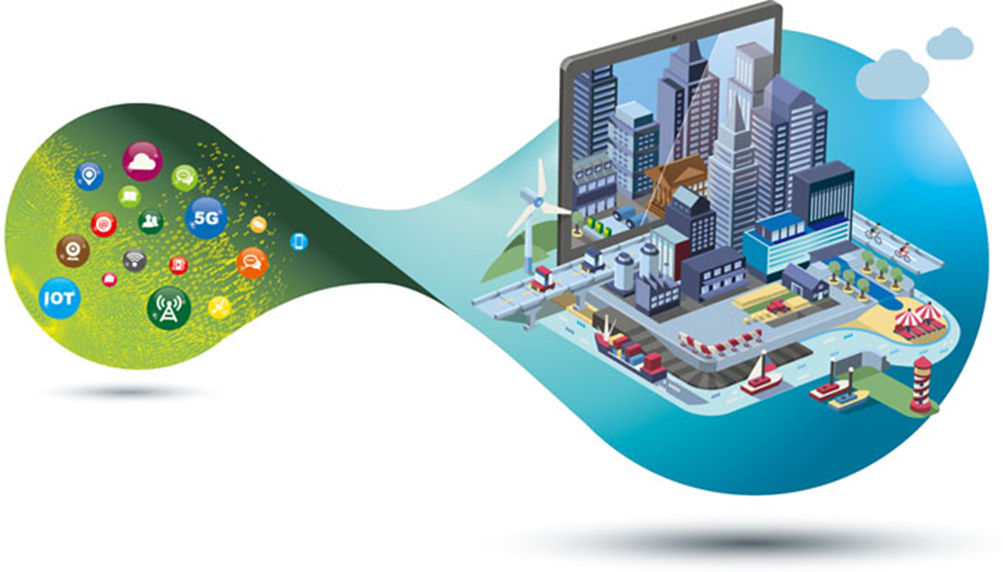
Digital economy
New approach to management

Slide 2
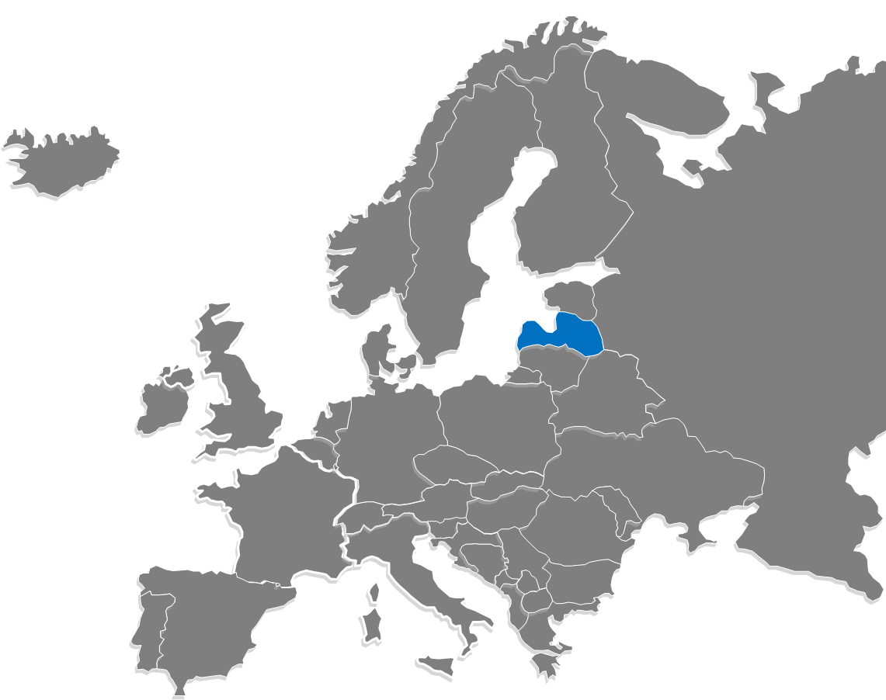

JELGAVA CITY INFOGRAPHIC
Fourth largest city in Latvia
Population ~ 61 000
There are 21 467 working places in Jelgava, of which 55% are occupied by residents from Jelgava and 45% by residents from the surrounding areas
Population age structure, %
Under working age
Working age
Over working age
17.2%
61.1%
21.7%

Slide 3
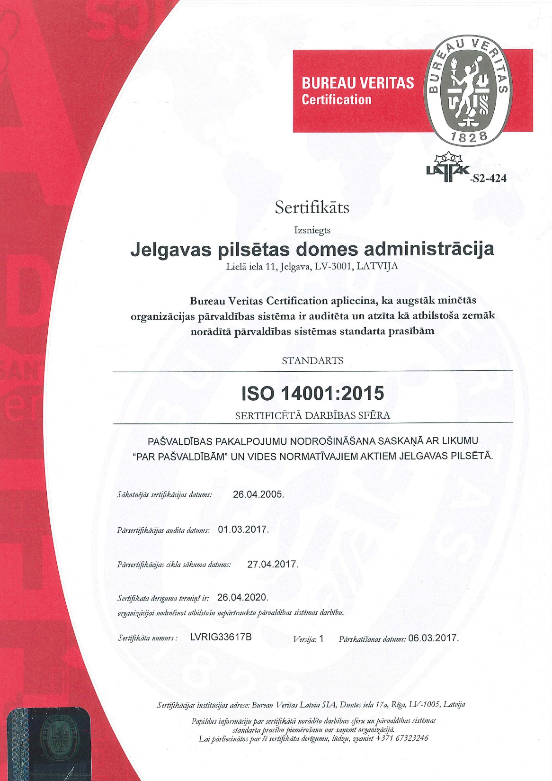

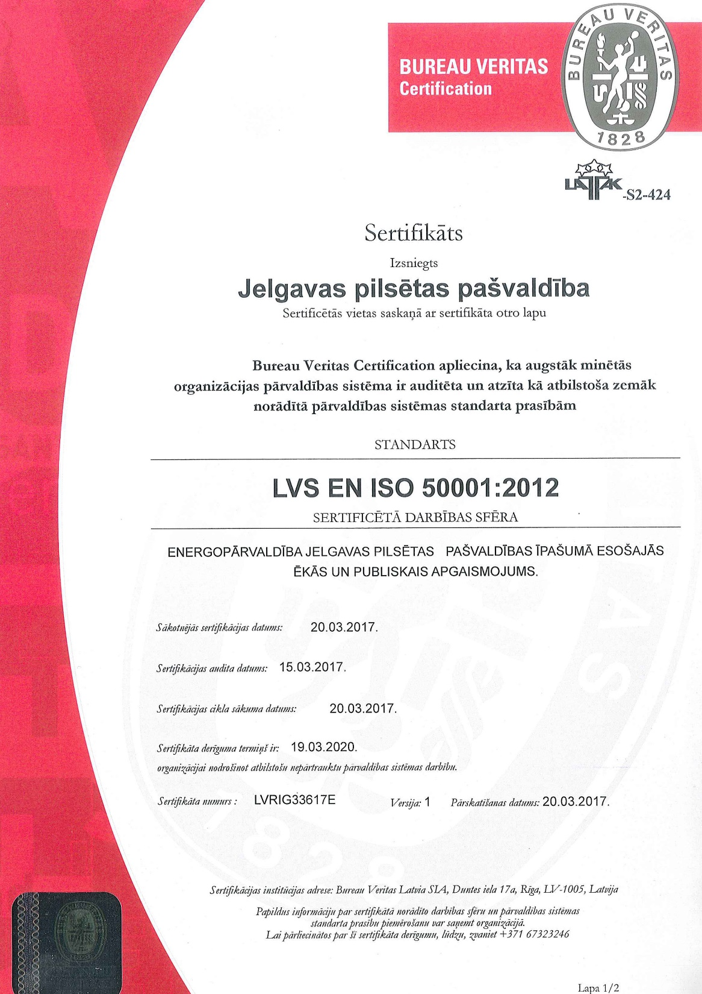
ISO 37120
Sustainable development of communities
In Progress

Slide 4

Jelgava - SmartCity
Welfare
Infrastructure
maintenance
Civil Protection

Slide 5
Digital Economy
DE = ((T + S) x B) ^ CU
T=Technology
S=Services
B=Business
CU=Culture
Economy - the activity of society, as well as the set of relations that develop in the system of production, distribution, exchange and consumption.

Slide 6
Digital Economy: Subjects and their purposes
Public sector
Private sector
Residents (households)
Reducing administrative burden
Impartial and immediate decision making
Loyalty of subjects (trust to each other)

Slide 7

Digital Economy: Tools
Autonomous management
Realtime
Analysis
Comunication
Smart
Infrastructure

Slide 8

Communication
Provided channels:
Opportunities:
Smart tools:
  Mobile app
  Citizen profile
  MasterCard CityKey card
Smart places
Citizen identification
Interaction using interactive documents
Controlling access to target audiences

Slide 9
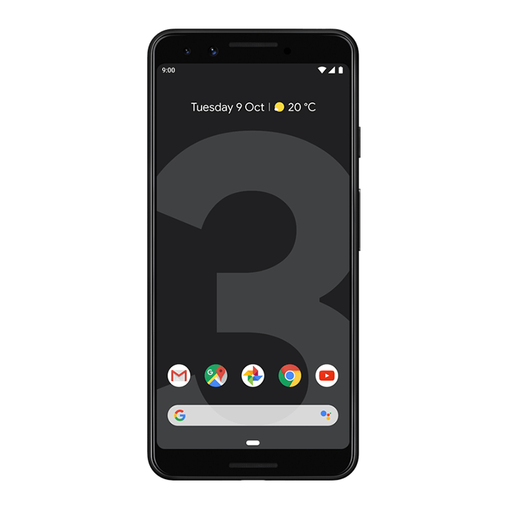
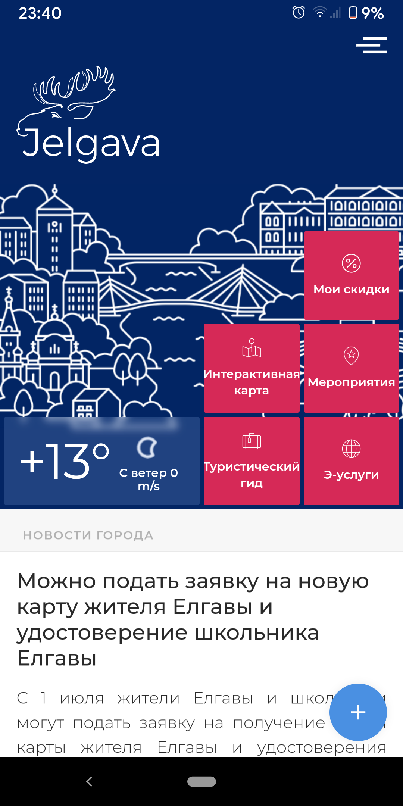
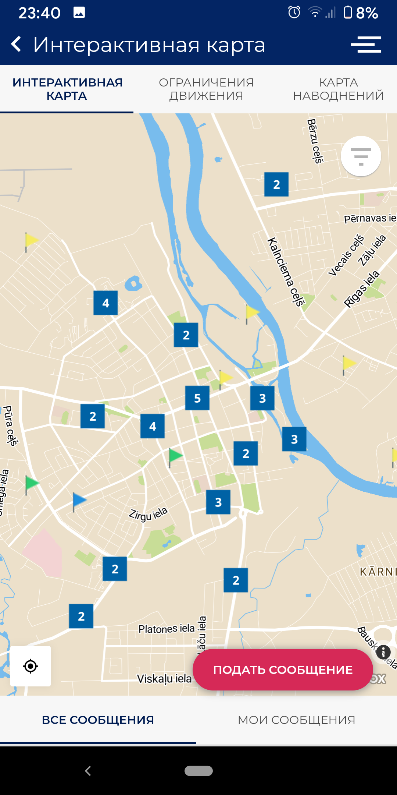
Communication
Information about the city and events
Tourist guide
Population polls, voting
Crisis situations
Marketing
City e-services

Slide 10
Autonomous management
Defining an event control rule
Execution of the procedure when an event occurs
Registration of results of procedure execution

Slide 11







Autonomous management: cashless payments
Entitles the benefit
Beneficiary
Welfare benefactor
(state, merchant)
The bank credits the amount of the benefit (s) to the buyer's account
Pays full cost for the service
Gives benefit details to the bank
Holds benefit’s funds
in the bank account
Real-time
Transaction details
Merchant

Slide 12

SME support
Stimulating demand with funds from the public and private sectors.
As a result:
increase in cashless turnover,
reduction of the shadow economy,
increasing tax collection,
increased investment in the private sector.
Benefits are transferred if the beneficiary purchases the specified product from the specified group of merchants
Quality control of social goods and services, because competition between merchants is maintained
Socialization of benefit groups of the population

Slide 13
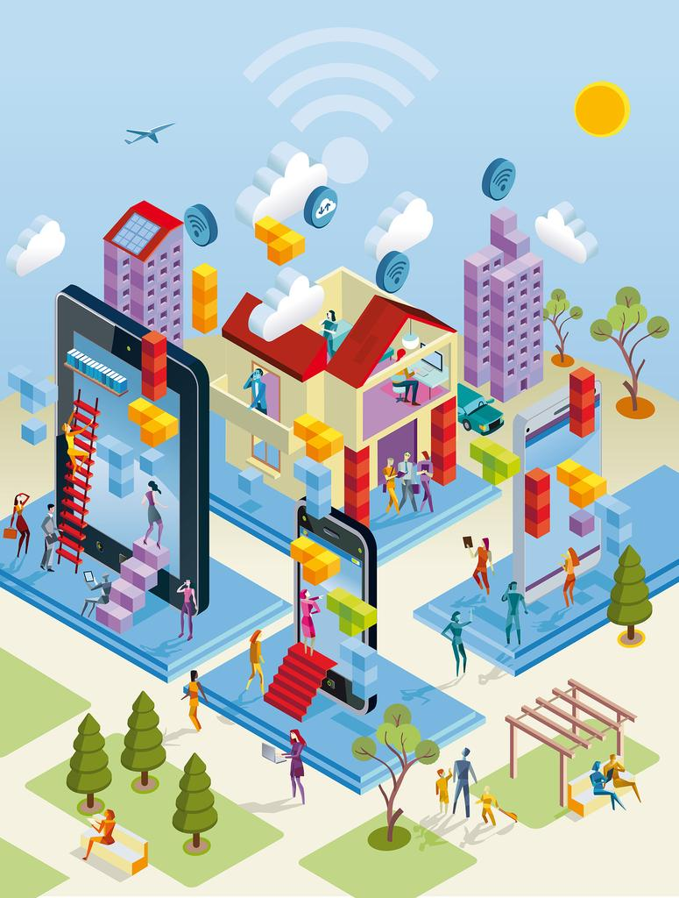
Realtime Analysis
Smart City Modeling according to
ISO 37120:2014 “Sustainable development of communities — Indicators for city services and quality of life” for all thematic objects and main indicators
Converting data from smart devices into information services for residents, businesses, administrations and tourists.
Control and prevention of adverse events in the city, ensuring the correct choice, management and prompt response to events in the city.

Slide 14


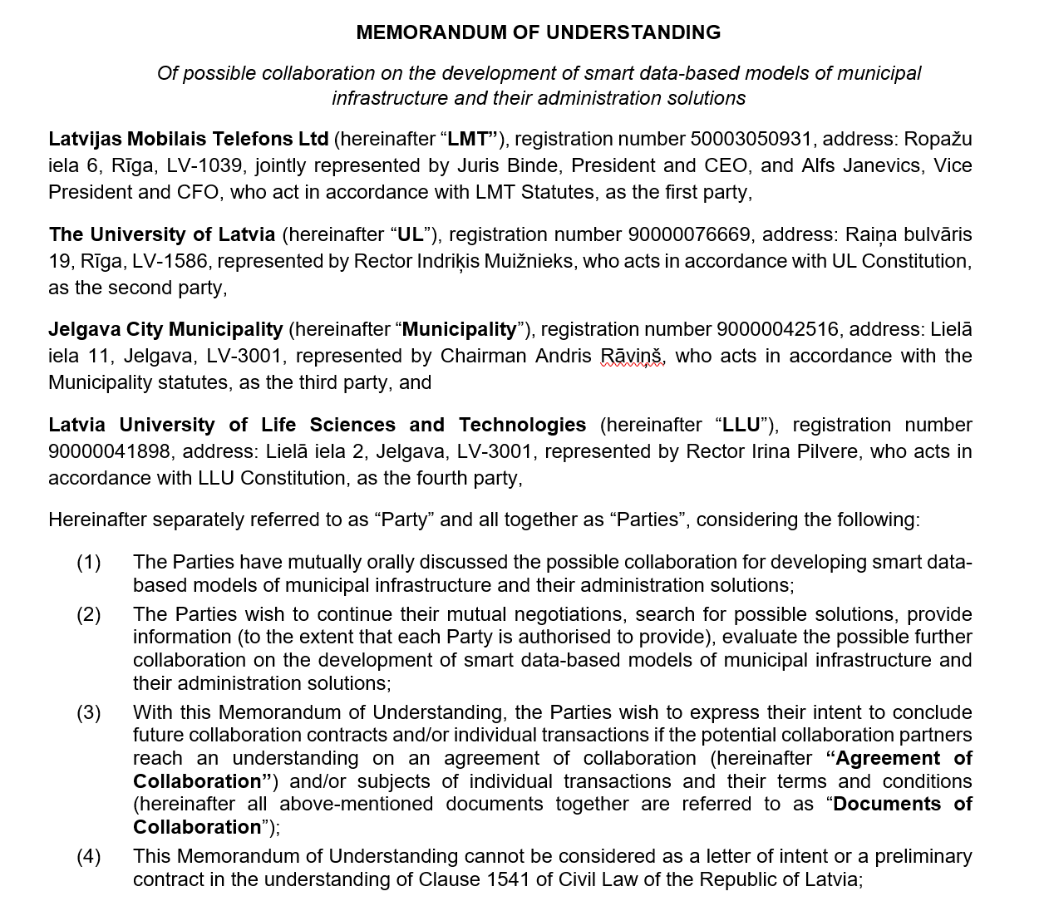


Data-based models development

Slide 15




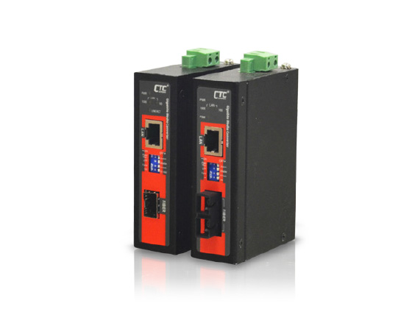
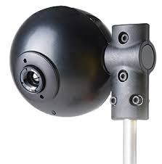
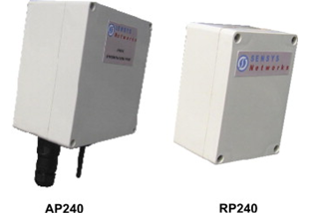
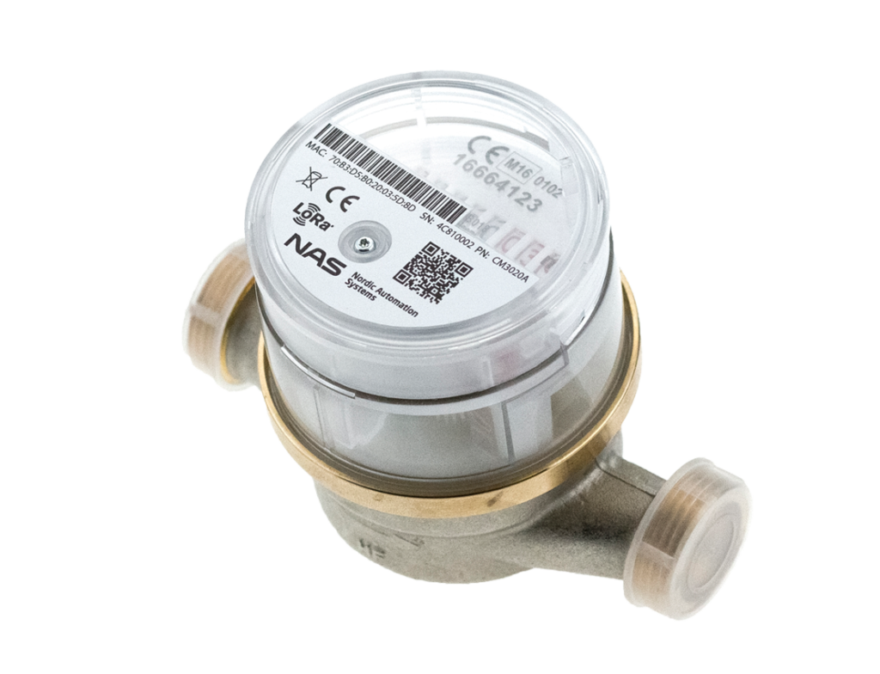
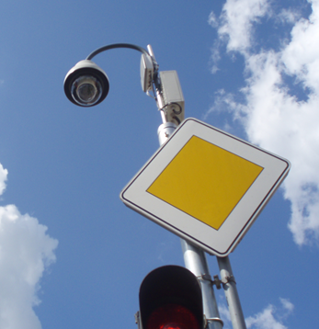
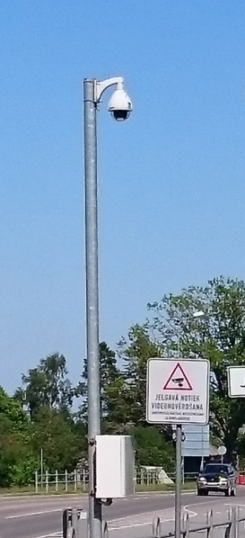


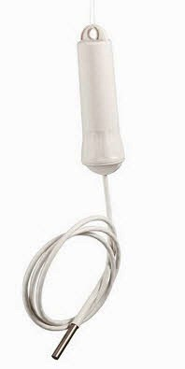

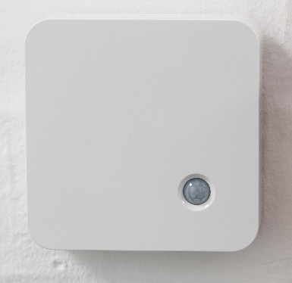

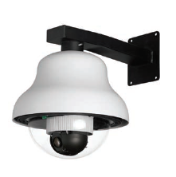
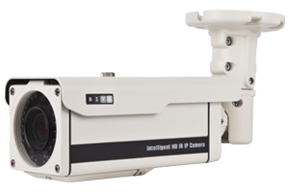
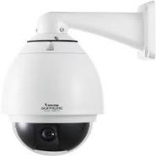
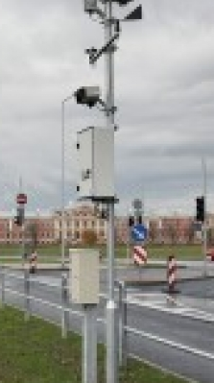
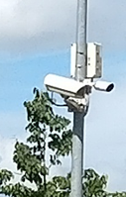
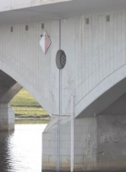
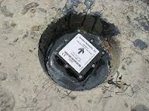
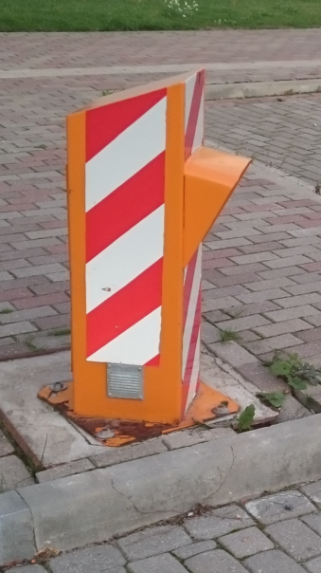
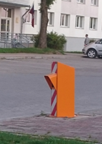
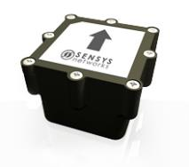
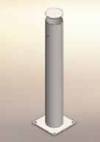
Smart Infrastructure

Slide 16






Smart Information Flow
Smart traffic light managment system
Infrastructure object management system
Transport flow data
Rain water pumping stations
Information to civil protection commission
Street light
Meteo stations
Video surveillance
Geographic position system (GPS)
Geospatial information system
GIS
24/7
Information to city management
Air quality control
Environment and civil protection
Water level control
Flood protection gates
Chemical spill and Radiation control*
Optical fiber
Communication
GPRS
Radio communication
Dialog with inhabitants
Municipal police
Cooperation partners
Fire rescue service
Water threatment
State police
Real estate administration
Calls from inhabitants 8787
Communication and flow of information
PUKS
Work orders to engineers
Interactive map
Mobile application
E-mails; meetings
Inspections of cities infrastructure

Slide 17
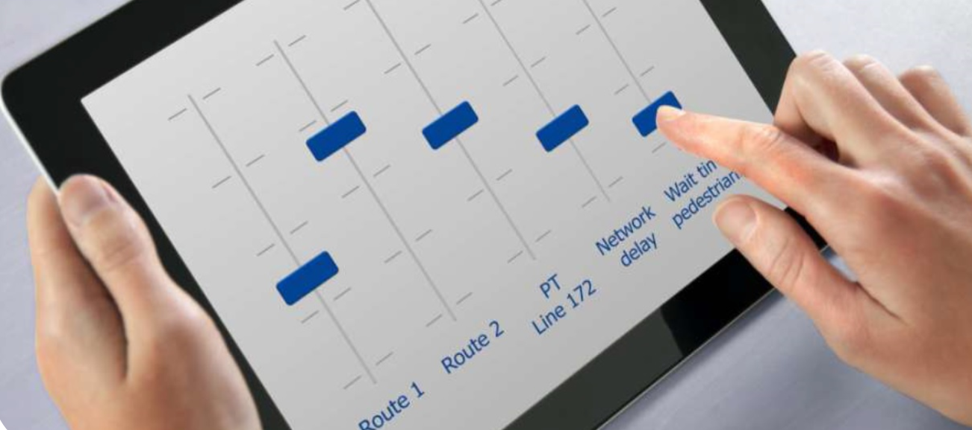
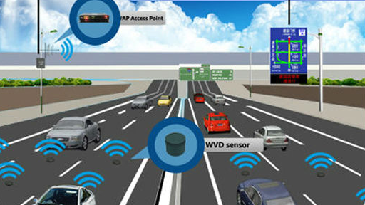
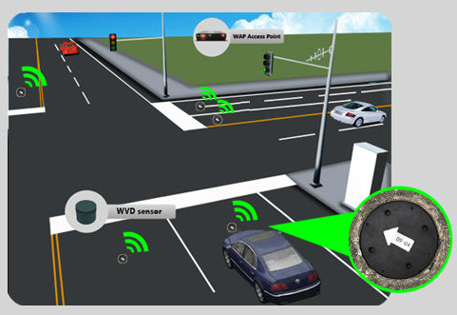
Real Time Traffic Optimization

Slide 18
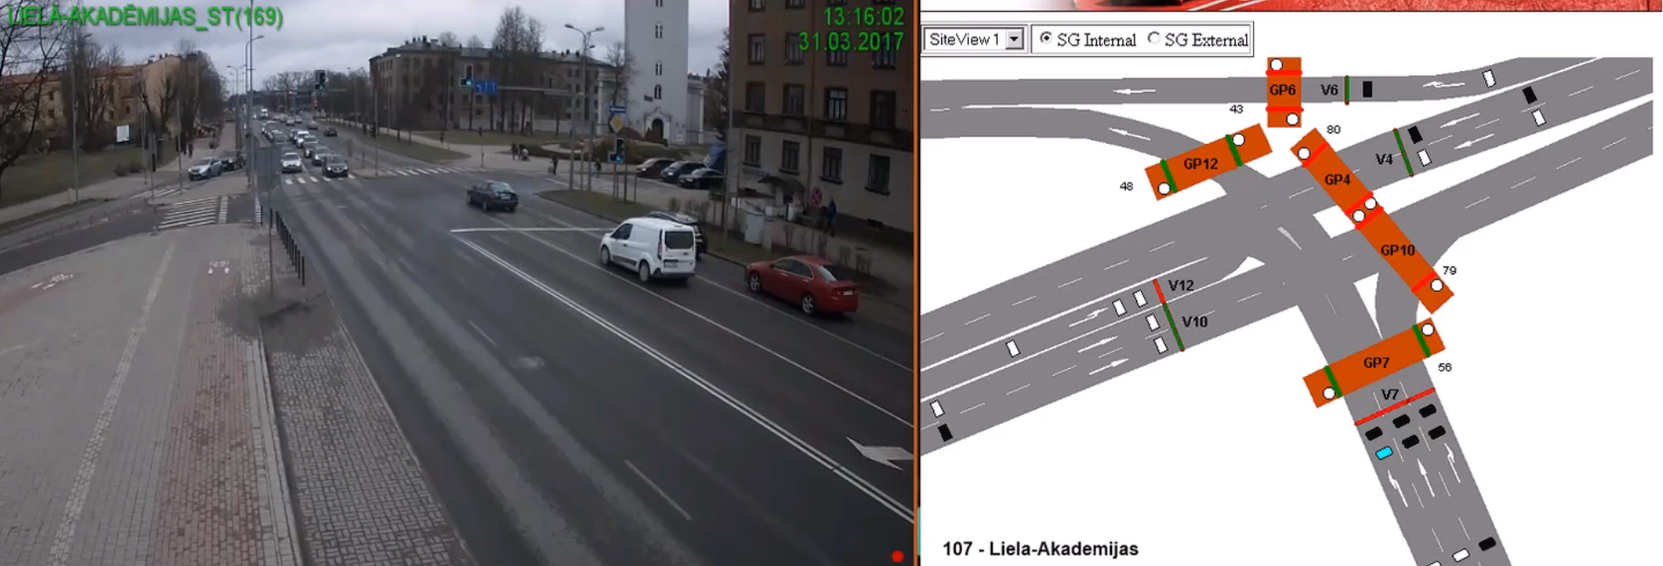
Real Time Traffic Optimization

Slide 19
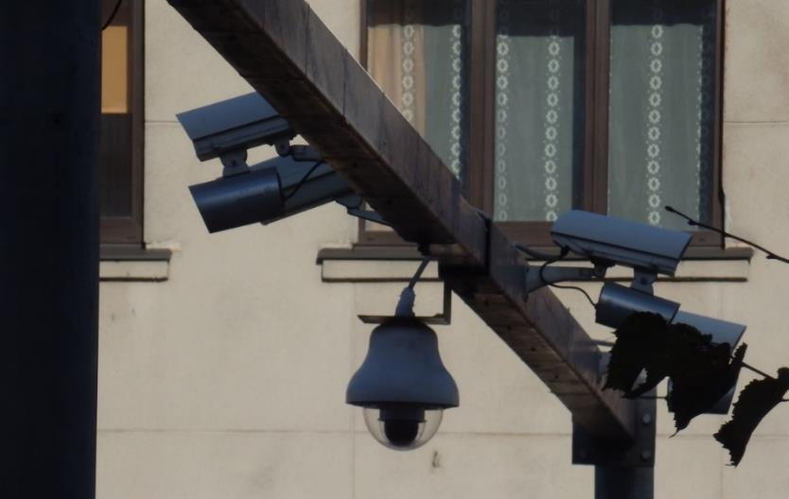
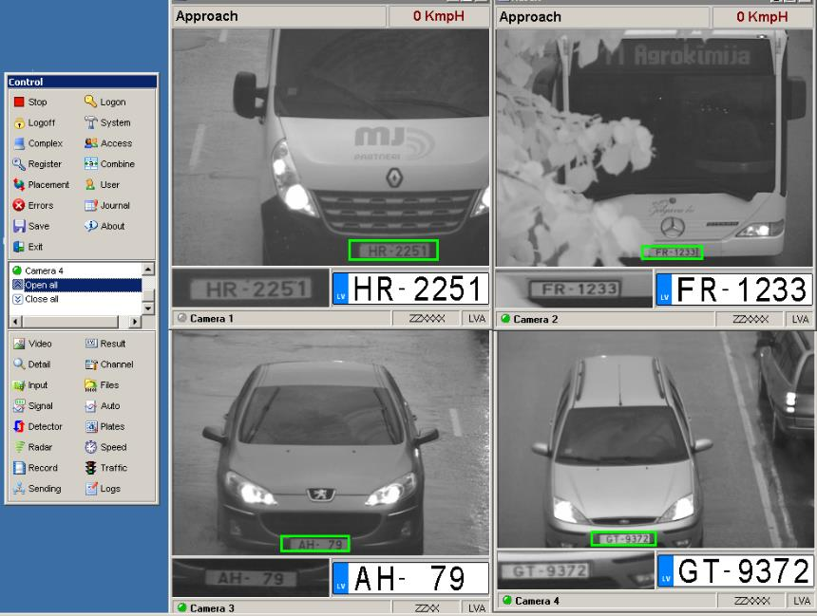
License Plate Recognition

Slide 20
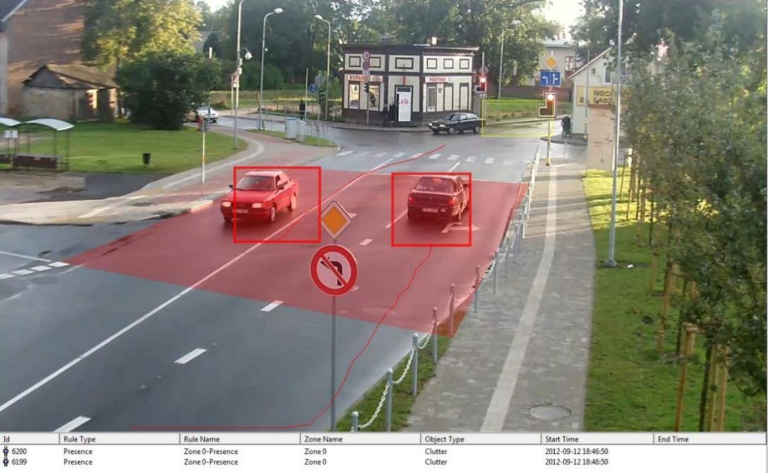
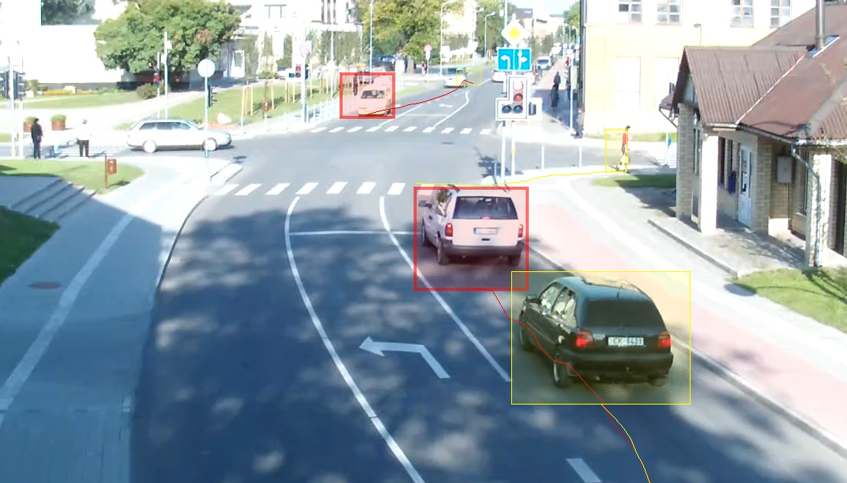
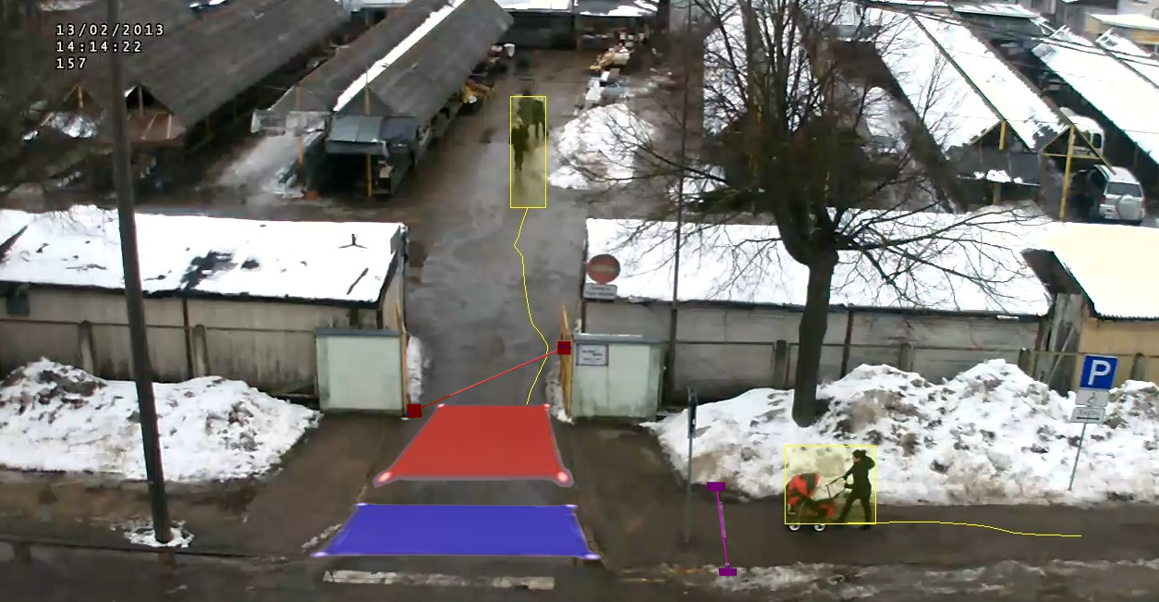
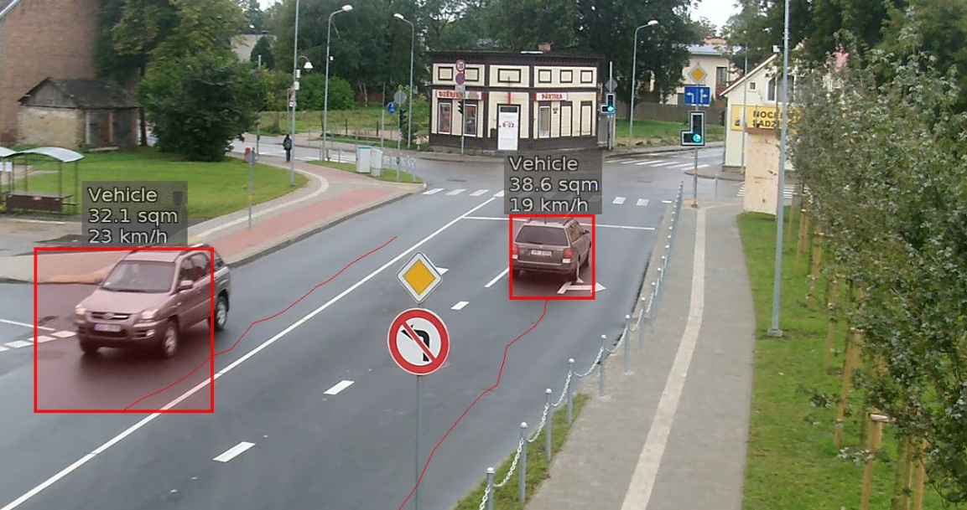
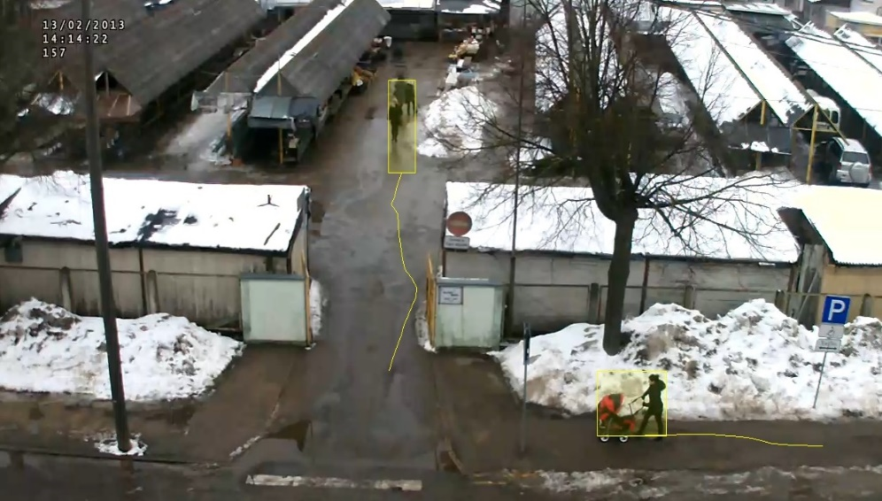
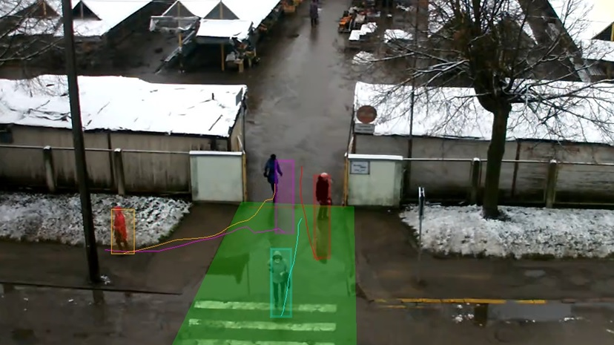
Video Analytics

Slide 21
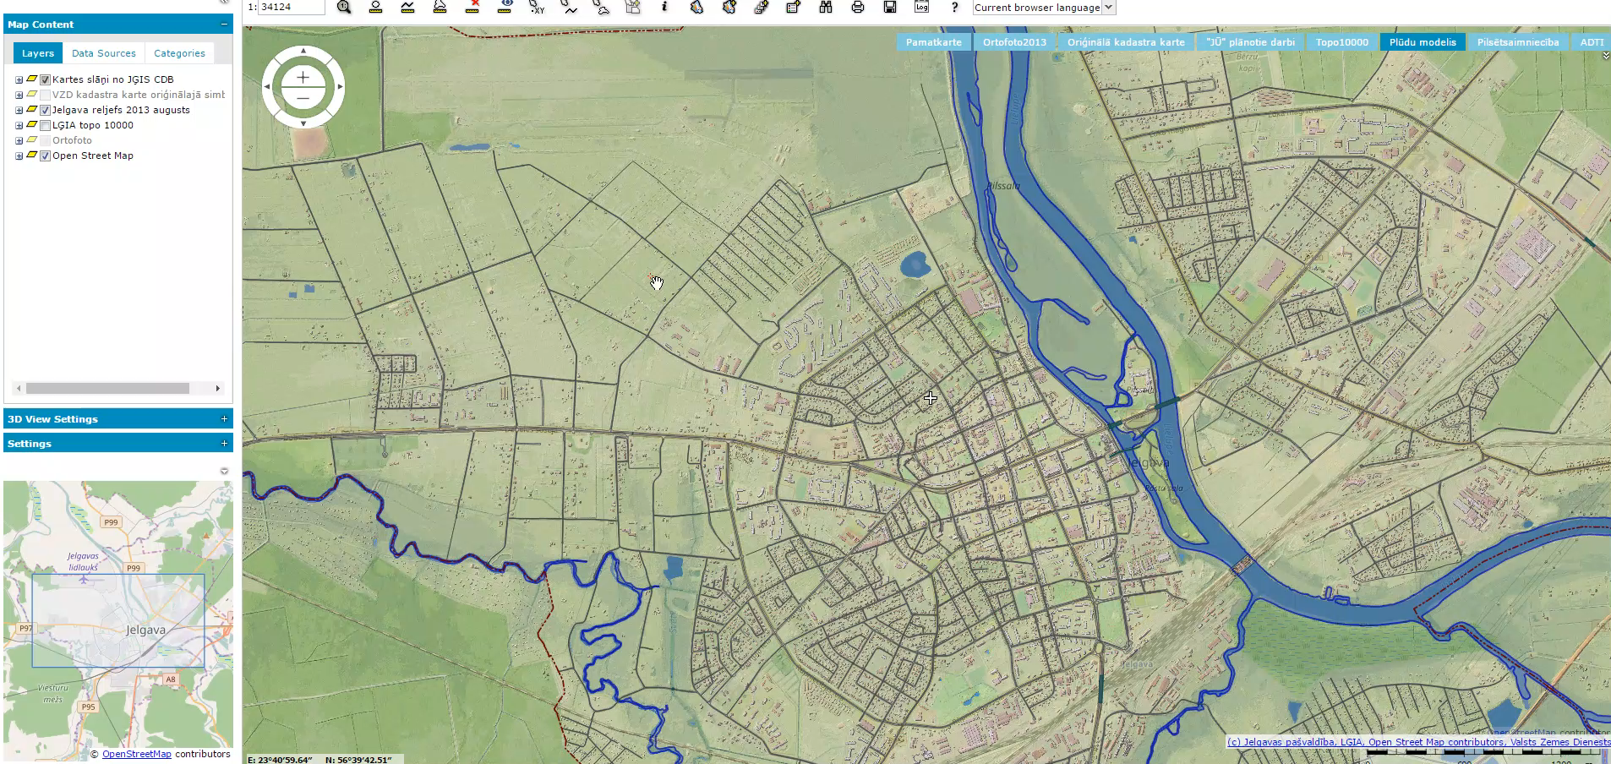
3D Flood Modelling

Slide 22
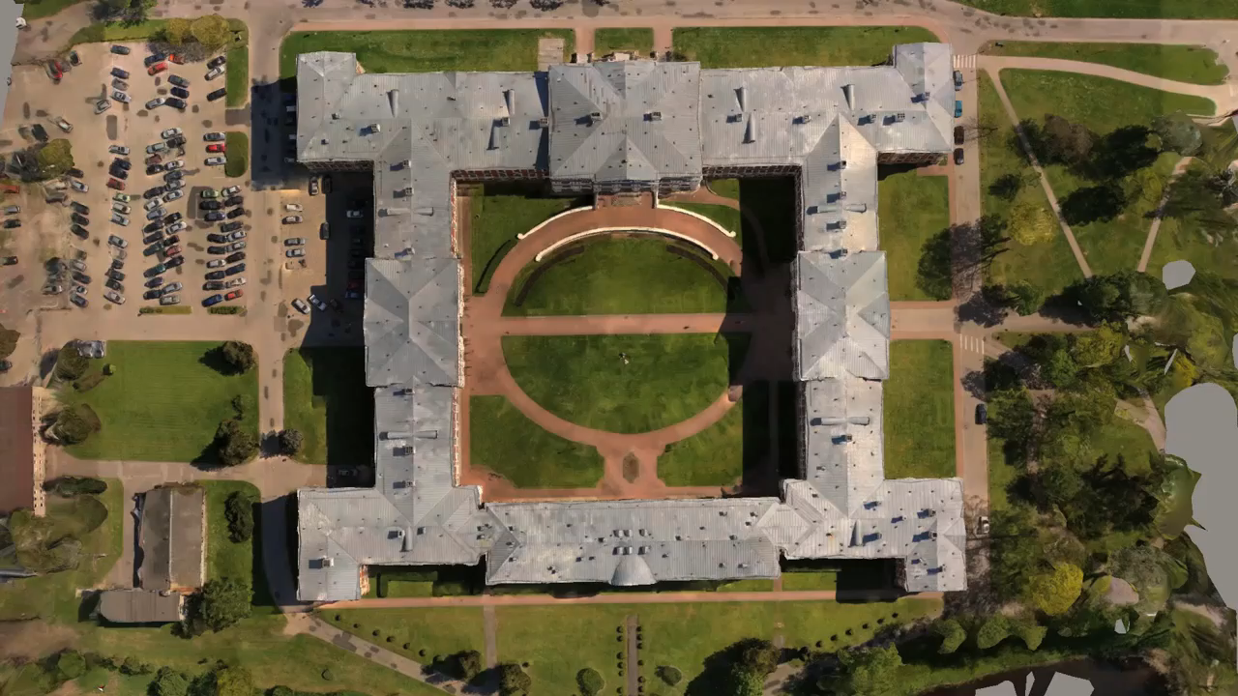
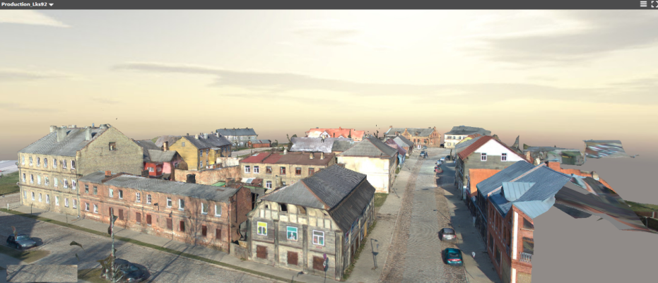
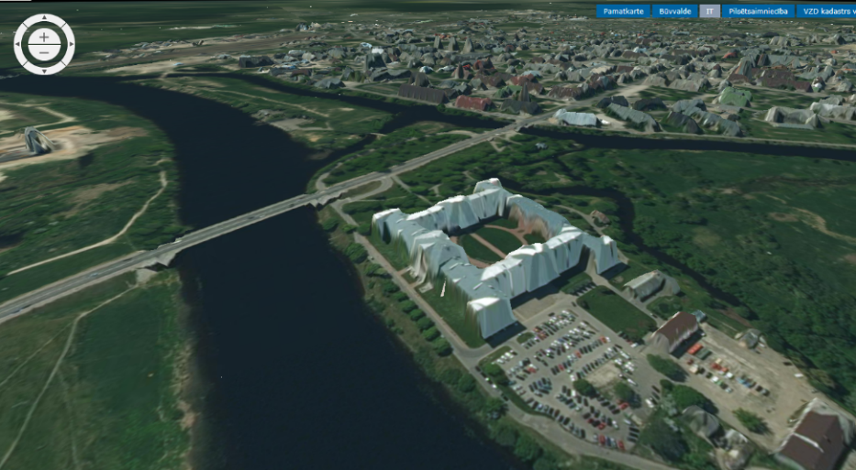
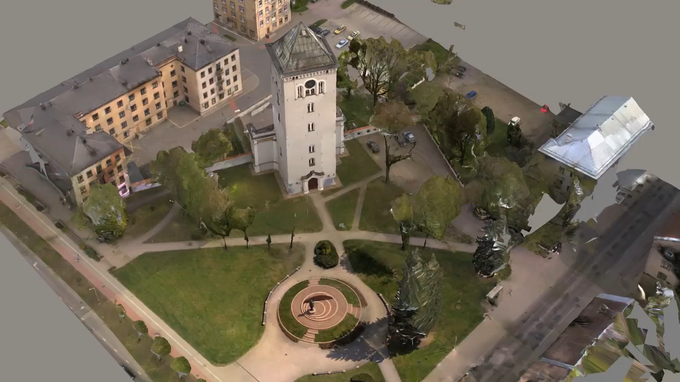
3D Technologies

Slide 23
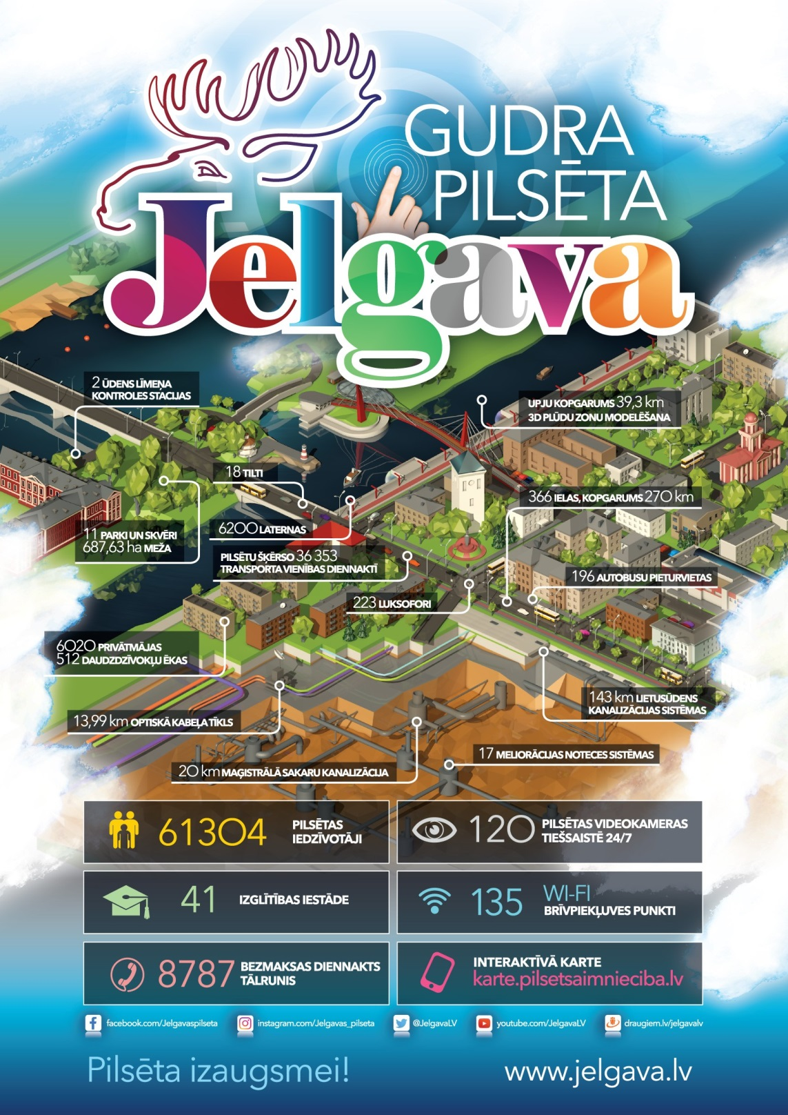

Paldies!*
*Thank you!

